Slide 1
Splitting a node in a B-tree

Slide 2
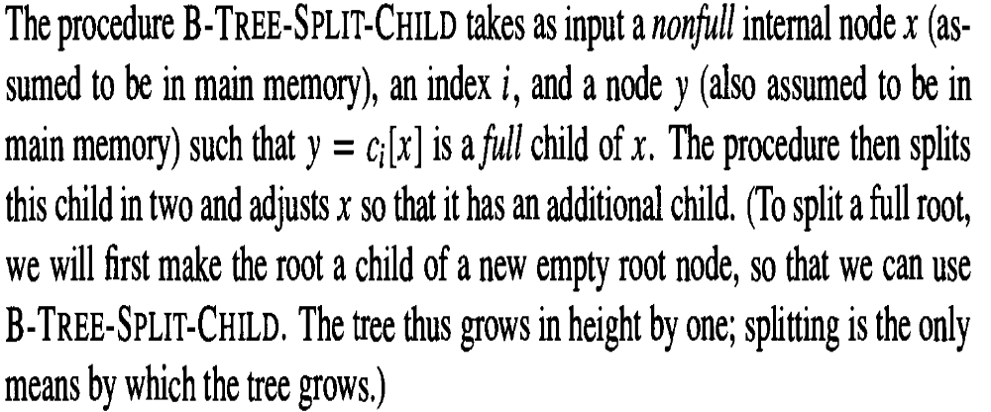
Splitting a node in a B-tree

Slide 3
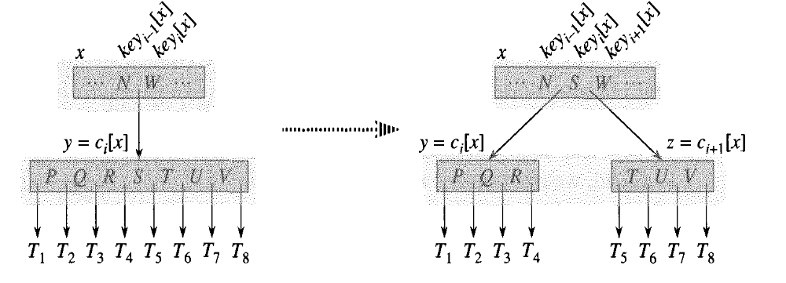

Slide 4
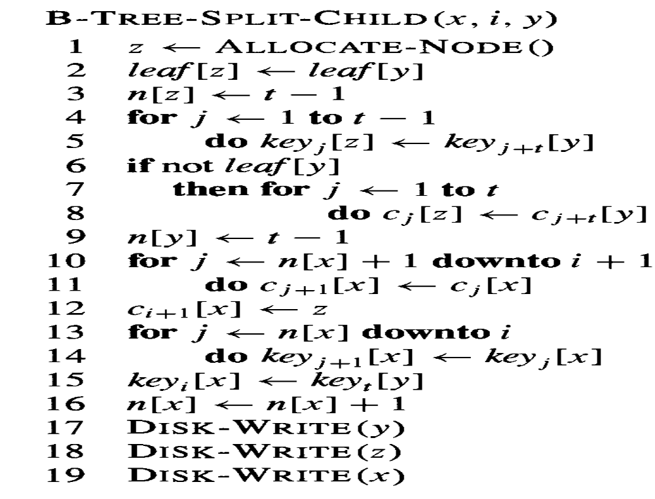
Splitting a node in a B-tree

Slide 5
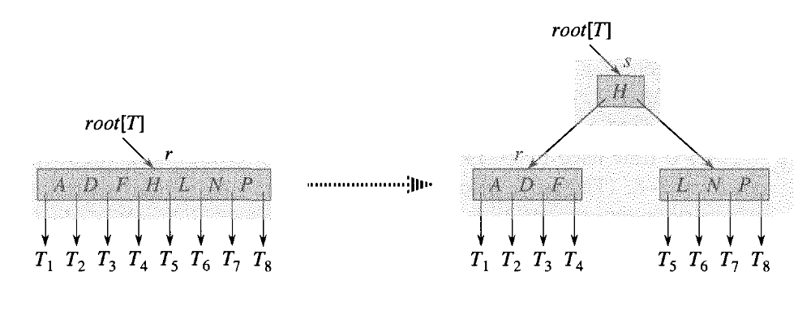

Splitting a node in a B-tree

